Slide 1
Btech 451
Project in Information Technology
Final Seminar
Yijing Wei

Slide 2
Outline
Distributed Service Profiler
Functions
Problems
Interface
Mockup
How it works
Hibernate Interceptor
EmptyInterceptor
LoggerInterceptor and LoggerManager
Stack trace
Future work
What I have gained

Slide 3
Project Overview – Distributed Service Profiler
An existing Distributed Service Profiler is used to display information about the communication between services
The information that it displays include
Argument Size
Return Size
Time taken for the method to complete
Number of hits

Slide 4
Project Overview – Distributed Service Profiler
Different services are connected through different port numbers
Displays calls made between services and information of these calls
Different services are used to control different things

Slide 5
Project Overview – Distributed Service Profiler
Problem
The current profiler does not include displaying information of calls made by services to the database
It is important to know the information about the queries, because sometimes it is the queries that take the longest time, and we want to find this bottleneck and improve it.
Goal
The goal of this project is to extend the current Distributed Service Profiler to integrate with the database layer to intercept queries made to a database and measure this information.

Slide 6
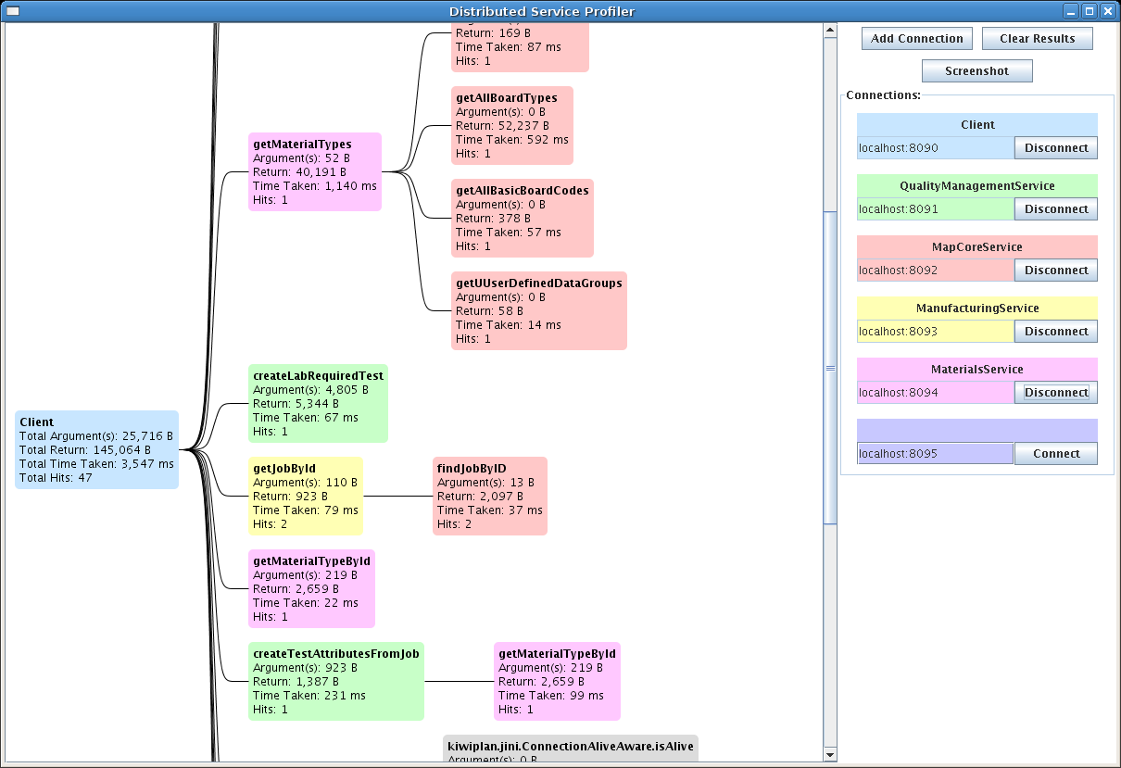

Slide 7
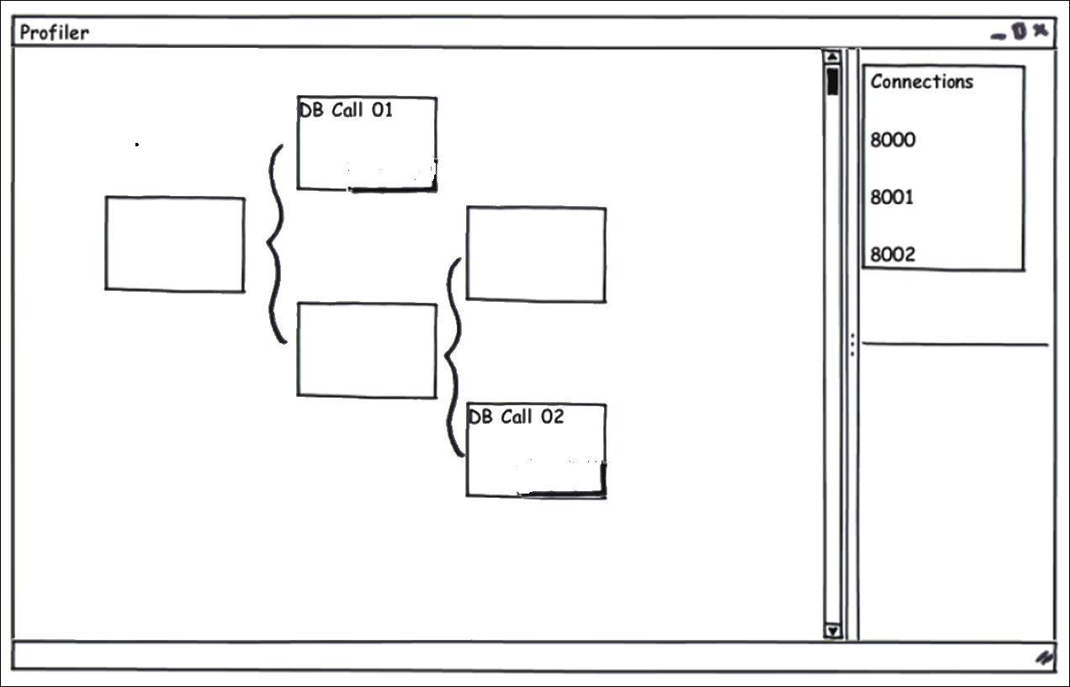

Slide 8
Distributed Service Profiler – How it works
ServiceProfilerAgent(Mbean) connects to various services using port number and registers to MBeanServer
Method calls are intercepted and information is stored in notification which can then be emitted by Mbean
Profiler uses JMX connector to find Mbean and listen for incoming notifications
Each service will have an associated index

Slide 9
Distributed Service Profiler – How it works
Information from the notification is extracted and stored in a MethodCallContainer
Method name
time taken for the method to process
argument bytes
return bytes
the number of hits
Nodes are created. Each node contains an instance of the MethodCallContainer
Call tree is built up using the index from which the notification came from

Slide 10
Distributed Service Profiler – How it works
Once an Mbean is created and registered, it can be used to emit notifications.
For an Mbean to emit a notification, it must implement the NotificationEmitter interface or extend NotificationBroadcastSupport.
A notification instance can then be created with the appropriate parameters and the method sendNotification() can be used to emit the notification.
A notification contains
A source (the object name of the Mbean)
A sequence number used to order notifications from the same source
A timestamp
A message
Can also contain other attributes depending on the type of notification they are.

Slide 11
Distributed Service Profiler – How it works
handleNotification() method is used to receive notifications.
Once a notification listener is added by calling addNotificationListener with the client listener and specific Mbean on the MBeanServer, the client can start receiving notifications from the Mbean.
handleNotification() will be invoked every time a notififcation is emitted from the Mbean.

Slide 12
Hibernate Interceptor
A Java interface which can be configured with an application and a database to intercept queries made to the database by that application
Will be invoked every time a select, update, insert or delete query is made to the database
Extends EmptyInterceptor and implement necessary methods

Slide 13
EmptyInterceptor
Usually we extend EmptyInterceptor to create a customized interceptor as only the necessary methods need to be implemented
The methods that I used
onSave()
onDelete()
onLoad()
onFlushDirty()
afterTransactionBegin()
afterTransactionCompletion()
The parameters passed into the methods provide the information on the entity being passed to the database

Slide 14
EmptyInterceptor
id | first_name | last_name | salary
001 | John | Williamson | 1000
updated
id | first_name | last_name | salary
001 | John | Williamson | 5000
onFlushDirty(Object entity, Serializable id, Object[] currentState, Object[] previousState, String[] propertyNames, Type[] types)
Is called when a row gets updated
entity is the object currently being updated - Employee
id is the id of this row - 001
currentState is the new values of this row – {001, John, Williamson, 5000}
previousState is the values before updated – {001, John, Williamson, 1000}
propertyNames is the column names – {id, first_name, last_name, salary}
types is the domains of the attributes – {integer, string, string, integer}

Slide 15
Hibernate Interceptor
In order to make Hibernate Interceptor work, we need at least the following:
An interceptor which extends the EmptyInterceptor and implement necessary methods
A table in the database
A POJO (Plain Old Java Object) class
A mapping file which maps the Java class to the table in the database
A Hibernate configuration file – hibernate.cfg.xml
The connection url of the database
The username
The password
A list of mapping files

Slide 16
LoggingInterceptor
Extends EmpyInterceptor interface
Intercepts the queries made to the database by the services
Uses the mapping files and configuration files in PersistenceWrapper.
Is injected in PersistenceWrapper for all services to use.

Slide 17
LoggingManager
Used to initialise the LoggerInterceptor and is passed as one of the parameters into the LoggerInterceptor to pass on the service name and logging status.
Used to communicate with the service profiler by extending MBeans

Slide 18
Stack Trace
Stack trace is used to match the database calls with the original service method calls. This is essential in order to be able to integrate the information from the interceptor with the profiler to build up a call tree.
The stack trace from the interceptor goes back to the point where the service makes the database call.
Thread.currentThread().getStackTrace() can be used to get an array of StackTraceElements. Each element in this array presents a single stack frame, and is a method invocation containing the declaring class, method name, file name and line number. getClassName() and getMethodName() can be called on each element
Thread.currentThread().getStackTrace() is called in the startQuery() method in LoggingInterceptor, which is called each time a database query is intercepted.

Slide 19
Stack Trace
Service method calls are stored as tree nodes. Database calls would originate from leaf nodes, i.e. their callers
Check the method names from list of leaf nodes with methods from stack trace.
Once the calls are matched, a new node will be created containing the database call and will be linked to the service method node (caller)

Slide 20
Future work
Integrating the LoggingInterceptor and the LoggingManager with the distributed service profiler
Creating database query node and displaying it
Testing

Slide 21
Problems Encountered
Hibernate, Mbeans, notifications, etc. were all new concepts
A lot of time was spent on doing research and looking through the source code of distributed service profiler.
The distributed service profiler interacts with other services, need to consider this interaction.

Slide 22
What I have Gained
Academic knowledge - Knowledge on various frameworks such as Hibernate, Mbeans, etc.
Experience with working on an actual project in a company – need to think about how different projects relate to each other
Development process
Analyzing the problem
Requirement specifications
Designing
Preparing the solution
Testing
Documentation and commenting

Slide 23
Thank you!
Questions?

